Slide 1


Vaishali Kadam
© All rights reserved by Fireblaze Technologies Pvt. Ltd.

Slide 2
Problem Statement
The bank wants to build a database system to manage their customers and employees. The system should allow the bank to store and retrieve information about customers and employees, such as their names, addresses, account balances, and job titles. The system should also allow the bank to track customer transactions, such as deposits, withdrawals, and transfers.
The bank wants to build a database to store information about their customers and employees.
The bank wants to be able to use the database to retrieve information about their customers and employees.
The bank also wants to be able to create views of the data in the database.
The bank wants to build the database from scratch using SQL. They want to start by creating an
ER model of the data.
The bank wants to be able to secure the database. They want to use
encryption to protect the data in the database.
© All rights reserved by Fireblaze Technologies Pvt. Ltd.

Slide 3

About the Data
Mini Project
– SQL Domain: Bank Management System
The Bank wants to build the database for their customer and employees with all the details like creating an account in a bank type of account which helps the bank to retrieve the data on one click so they can find out the day to day update easily on their database. In this project, you have to build the database from scratch by using all the languages in SQL. First, you have to create an ER Model of the data and check the connection was correct or not also apply some all the keys in the ER Model and then go to the next step which is creating your own schema with name bank and start creating a table as per they required Here I share a table and the details.
Table that we use in this Project are as follows:
Bank Details : Branch_code [p] (N) Address(V) Department_id [F](N) Branch_name(V) State(V)
Employees: Employee_id [P][N] First_name[V] Department_id[N][F] Manager_id[N] Job_id[V][F] Email[V] Hire_Date[D] Phone_no[V] Salary[N]
Customer : Account_No[P][N] First_Name[V] City[V] Branch_code[F] Employee_id[F][N]
Phone_no[V] ATM NO [N][U] Exp_date [D] Pin_No[U][N]
Department : Department_id [P] (N) Department_name (V) Manager_id (N) Employee_id(N)
Account_no(N)[F]
Job_Details : Job_id[P][N] Department_id[F] Branch_code[F]
Account_Type : Account_no[P][N] Type_Acc ount[V] Manager_id[N] Department_name[V] Opening_Date[D]
© All rights reserved by Fireblaze Technologies Pvt. Ltd.

Slide 4
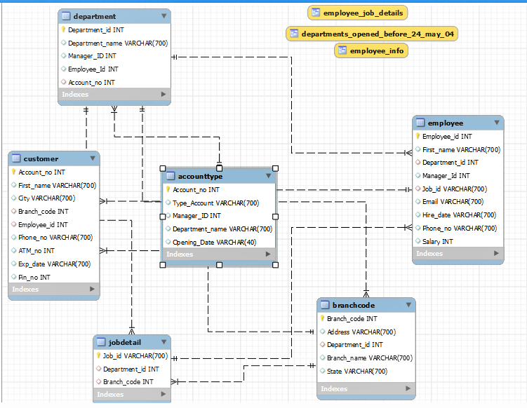
ER Diagram of Data
ER Diagram of Library Management System
ER in SQL stands for Entity Relationship
It is a conceptual model used to design a database.
An ER model is a graphical representation of the data elements and relationships for a specified system.
It also develops a very simple and easy to design view of data.
In ER modeling, the database structure is portrayed as a diagram called an entity-relationship diagram.
© All rights reserved by Fireblaze Technologies Pvt. Ltd.

Slide 5
Proposed Solution
1. Create an ER model
The first step is to create an ER model of the data. This will show the relationships between the
different tables in the database.
2. Create the tables and relationships
Once the ER model is complete, the next step is to create the tables and relationships in the database.
This can be done using SQL commands.
3. Populate the tables with data
Once the tables are created, the next step is to populate them with data. This can be done by importing data from a
CSV file or by entering it manually.
4. Create views
The bank wants to be able to create views of the data in the database. Views can be created using SQL commands.
5. Secure the database
The bank wants to secure the database by using encryption. This can be done by using a tool like MySQL Workbench
6. Use SQL to interact with the database
The bank wants to be able to use SQL to interact with the database.
This will allow them to retrieve information about their customers and employees, create views, and secure the database.
7. Monitor the database
The bank wants to monitor the database to ensure that it is running smoothly and that the data is secure.
This is just a proposed solution. The specific steps that need to be taken will vary depending on the specific requirements of the bank.
© All rights reserved by Fireblaze Technologies Pvt. Ltd.

Slide 6
Conclusion
Automated bank management systems can automate a variety of tasks, such as account opening, customer onboarding, transaction processing, fraud detection, and compliance.
To be successful, automated bank management systems must be scalable, secure, reliable, and cost-effective.
Banks can follow best practices such as using a scalable architecture, using secure protocols, implementing redundancy, and using a continuous integration and continuous delivery (CI/CD) pipeline to ensure that their automated bank management systems are successful.
Automated bank management systems are becoming increasingly important as banks face growing competition and regulatory requirements.
The development and deployment of these systems can be complex and challenging, but the potential benefits are significant.
Banks that invest in automated bank management systems are well-positioned to succeed in the digital age.
© All rights reserved by Fireblaze Technologies Pvt. Ltd.

Slide 7
Future Scope
Increased efficiency
Improved accuracy
Enhanced security
Improve customer service
Expand into new markets
Minimize workload
Overall, the future scope of manual to automated bank management systems is very bright. As banks continue to adopt digital transformation initiatives, there will be a growing demand for these systems. This is a growing field with many opportunities for qualified candidates.
© All rights reserved by Fireblaze Technologies Pvt. Ltd.

Slide 8
THANK YOU
© All rights reserved by Fireblaze Technologies Pvt. Ltd.

